Slide 1
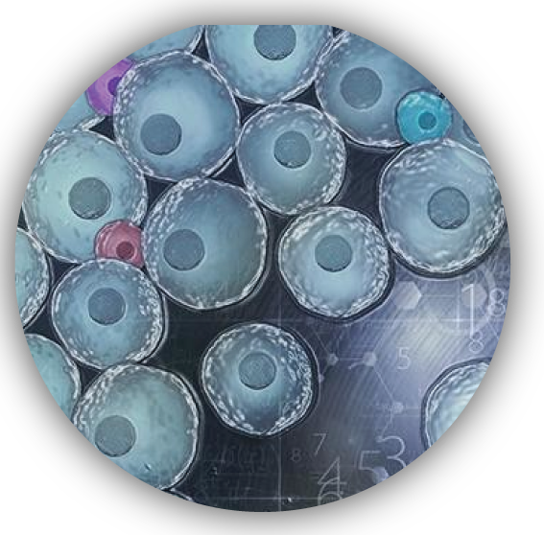
生物信息研究前沿： 单细胞测序
郭安源 教授
华中科技大学
guoay@hust.edu.cn

Slide 2
Outline
单细胞技术背景和需求
10X genomics 高通量单细胞技术
单细胞获取+测序技术
临床应用前景

Slide 3
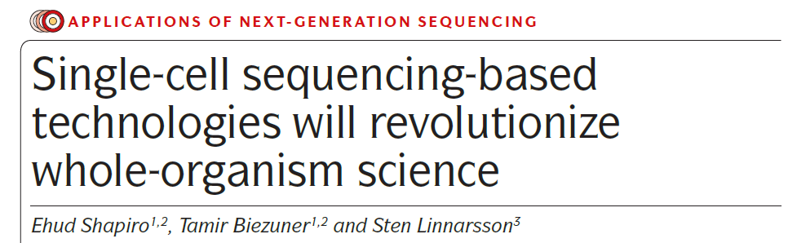

Nature review genetics 2013

Slide 4
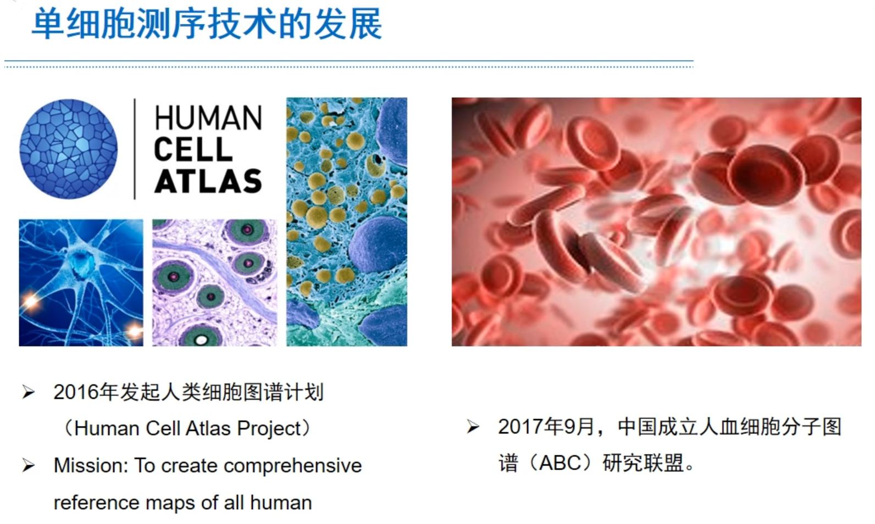

Slide 5
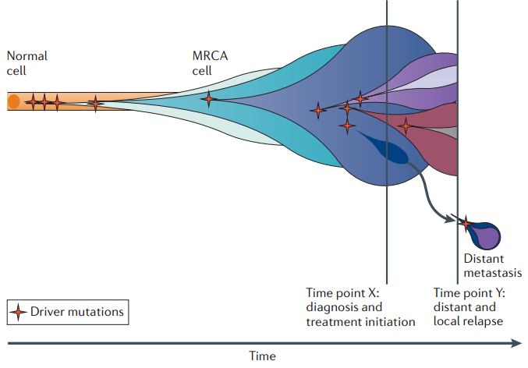

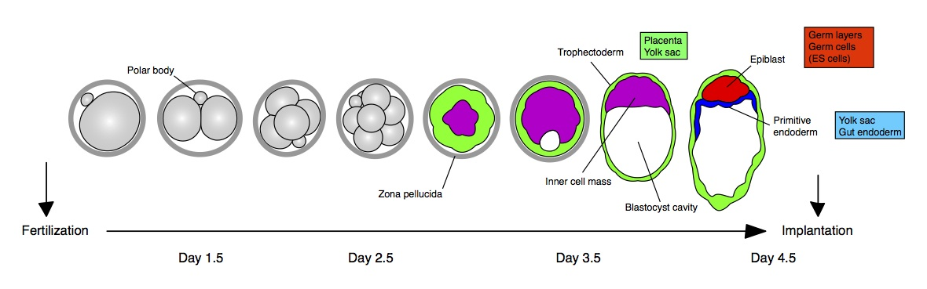
Why need single cell analysis
Cancer Heterogeneity
胚胎发育

Slide 6
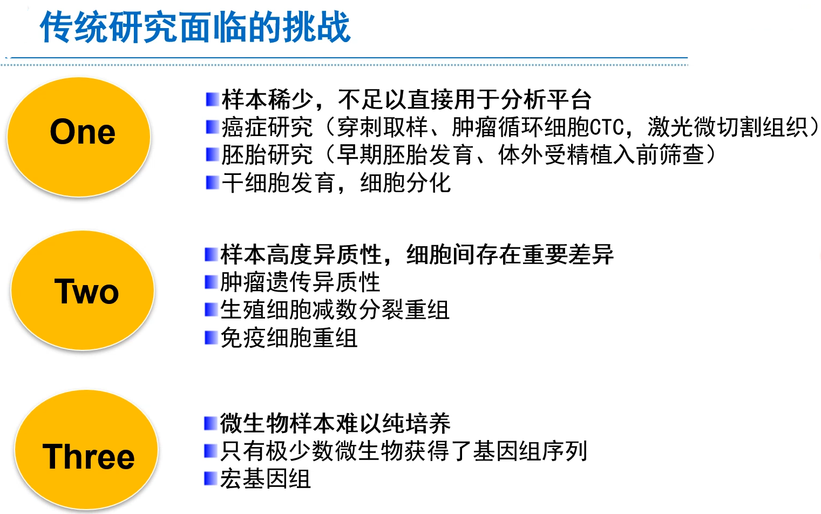
Why need single cell analysis

Slide 7
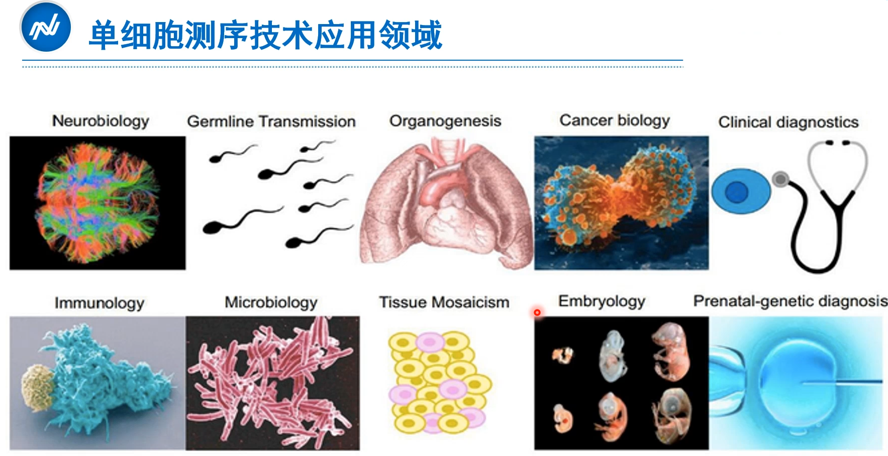

Slide 8
Outline
单细胞技术背景和需求
10X genomics 高通量单细胞技术
单细胞获取+测序技术
临床应用前景

Slide 9
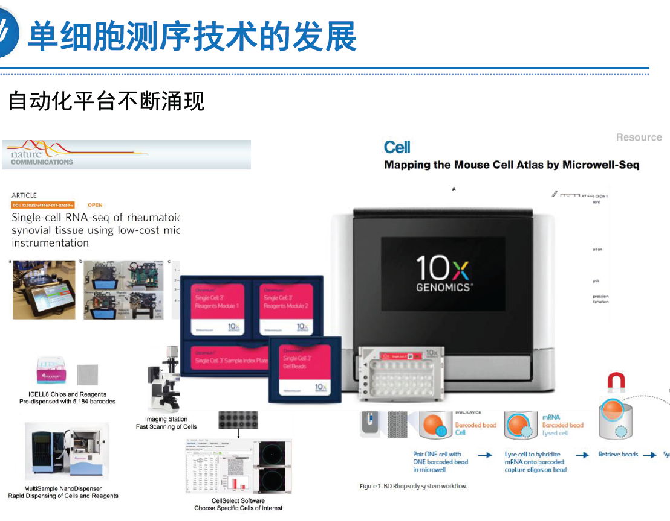

Slide 10


Slide 11
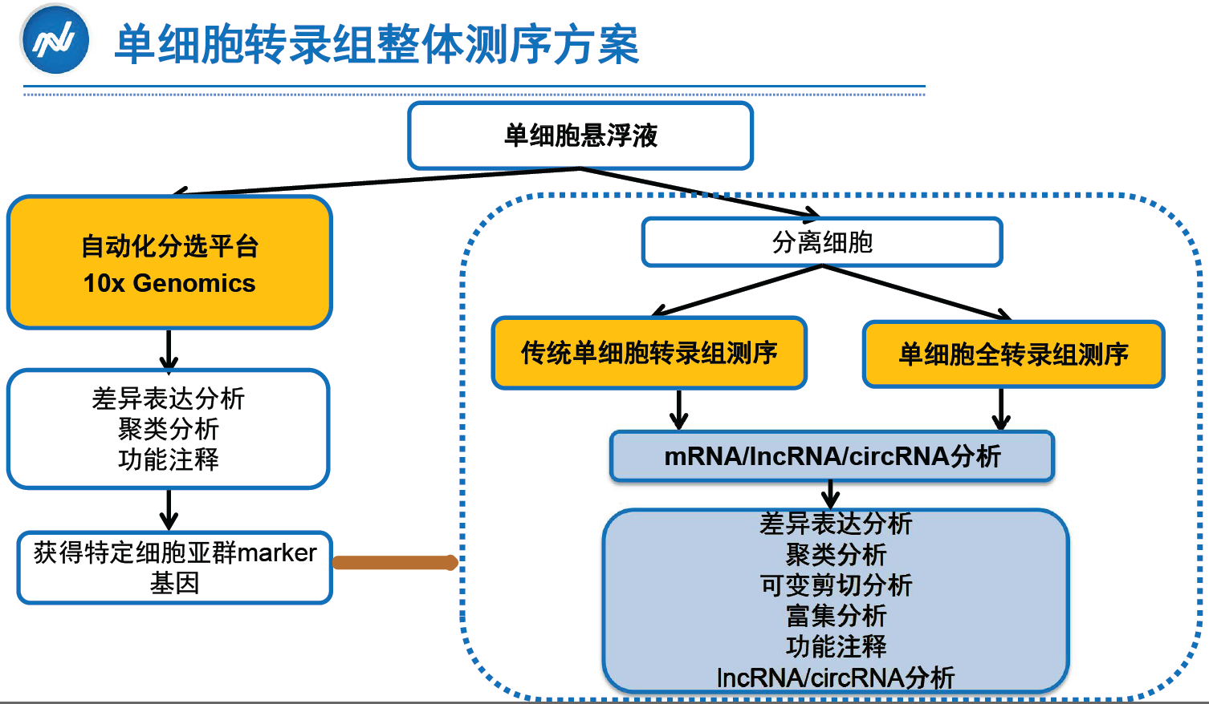

Slide 12
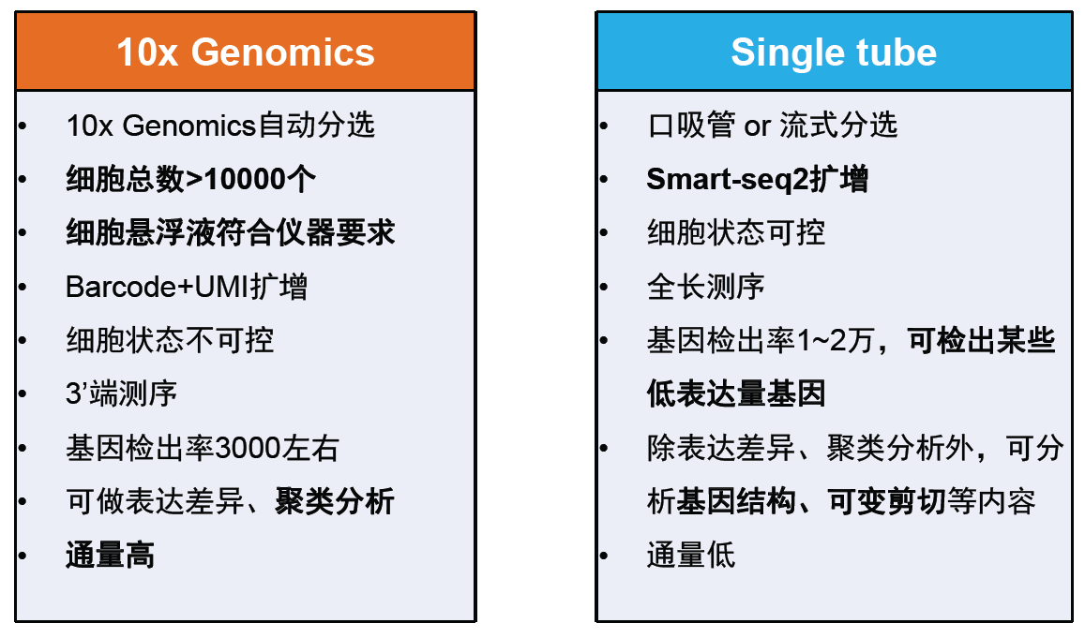
自动化分选平台 or 传统分离方法

Slide 13
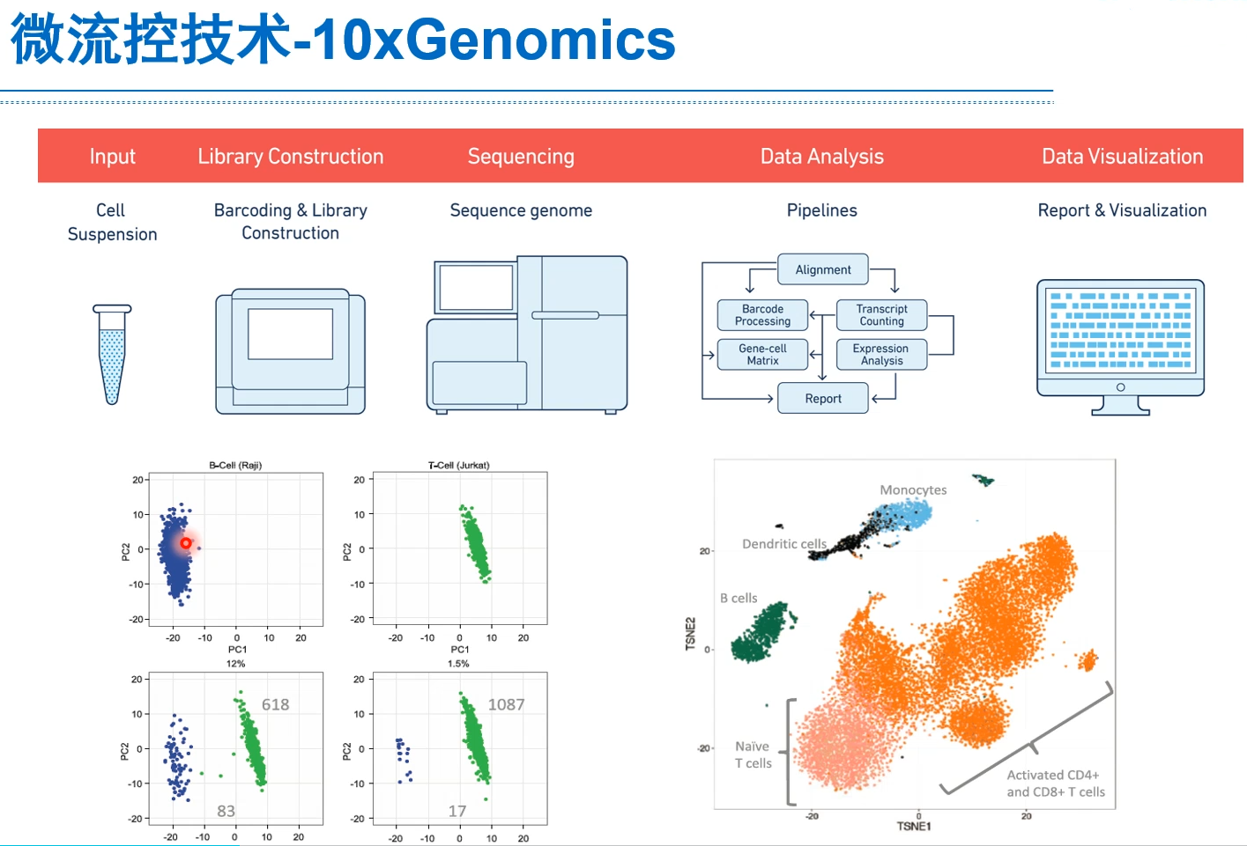

Slide 14

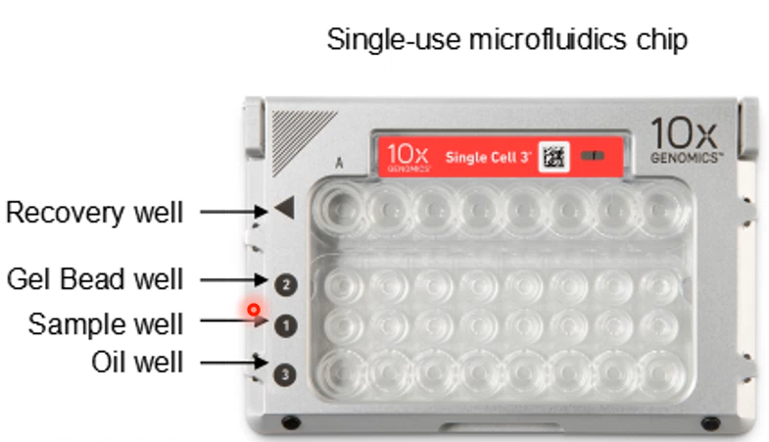

Slide 15
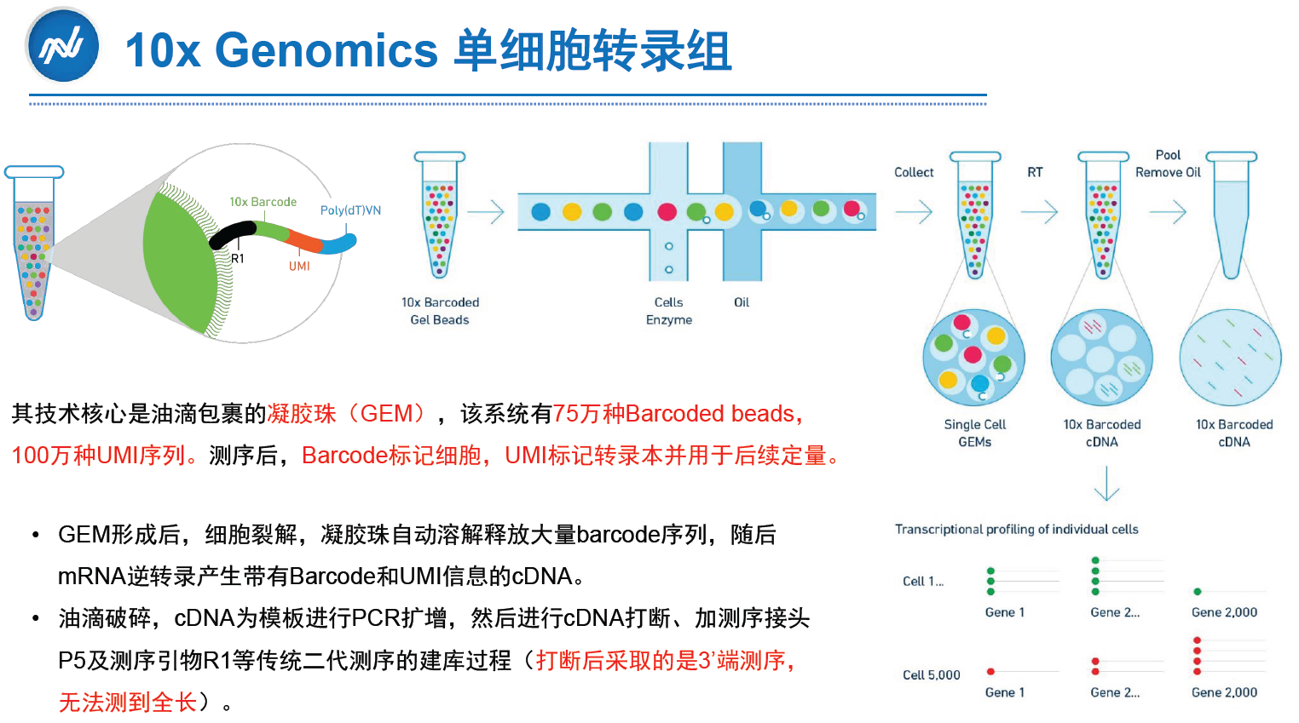

Slide 16
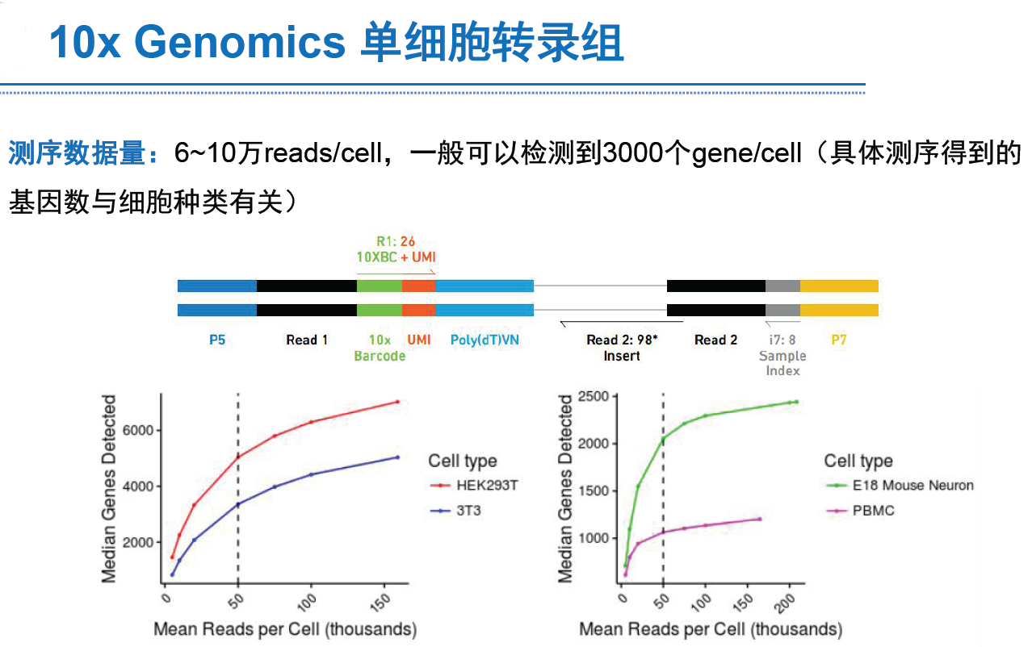

Slide 17
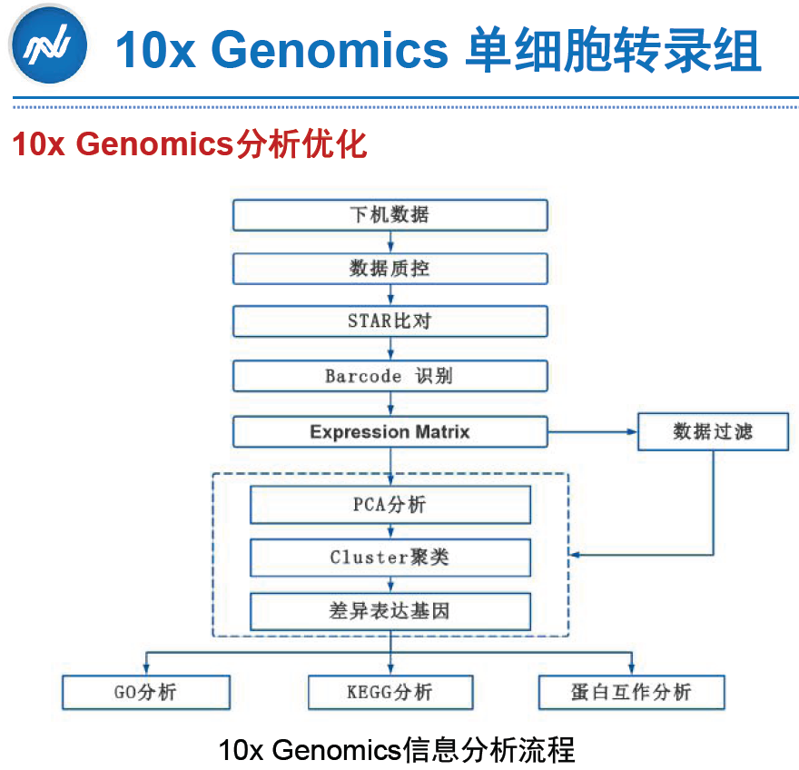

Slide 18
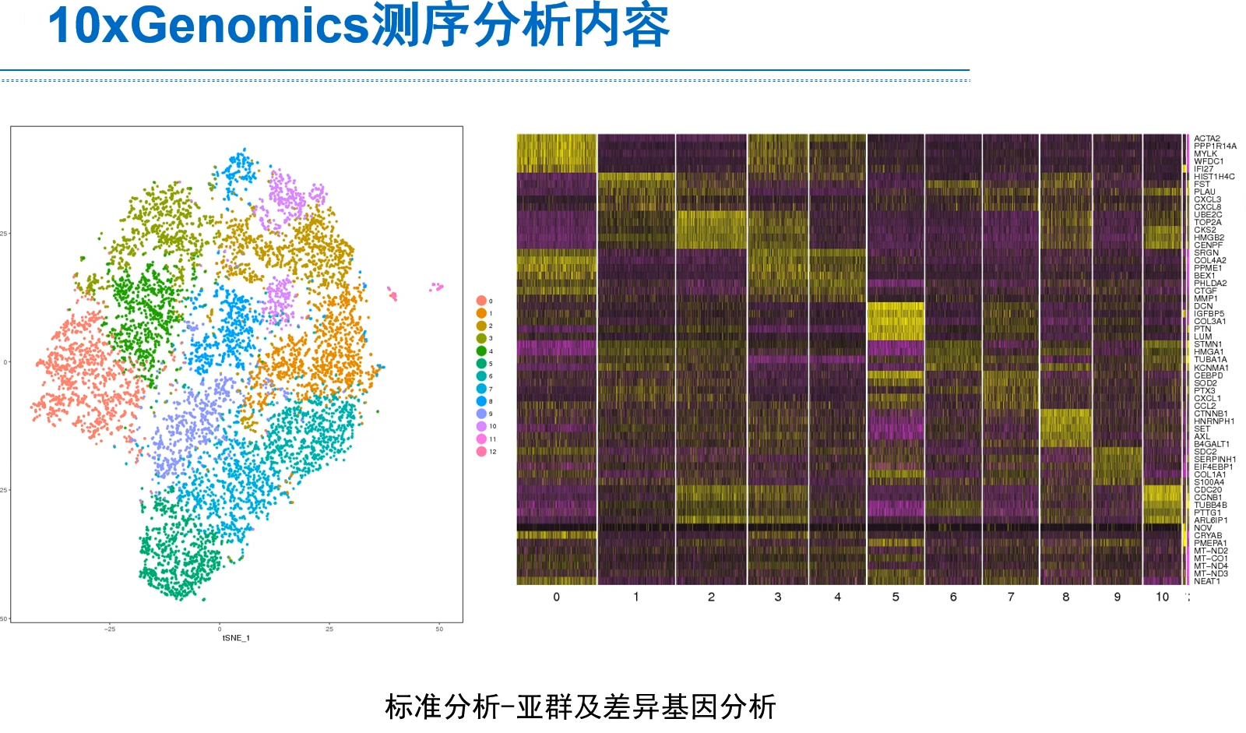

Slide 19
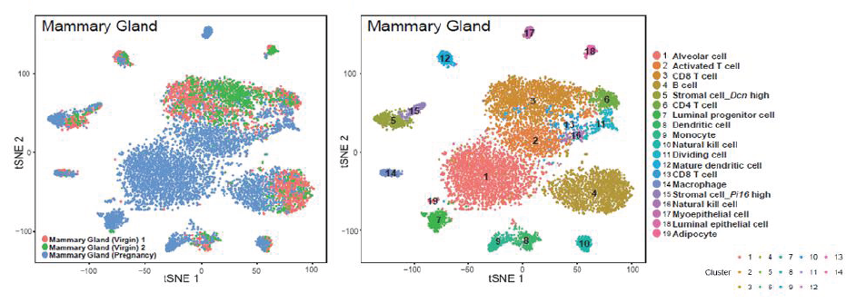
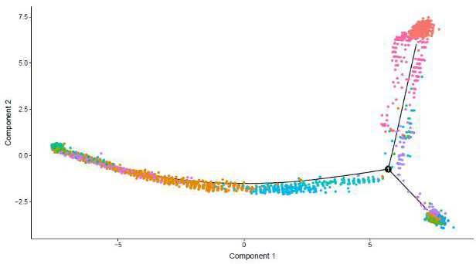
10x Genomics 单细胞转录组分析

Slide 20
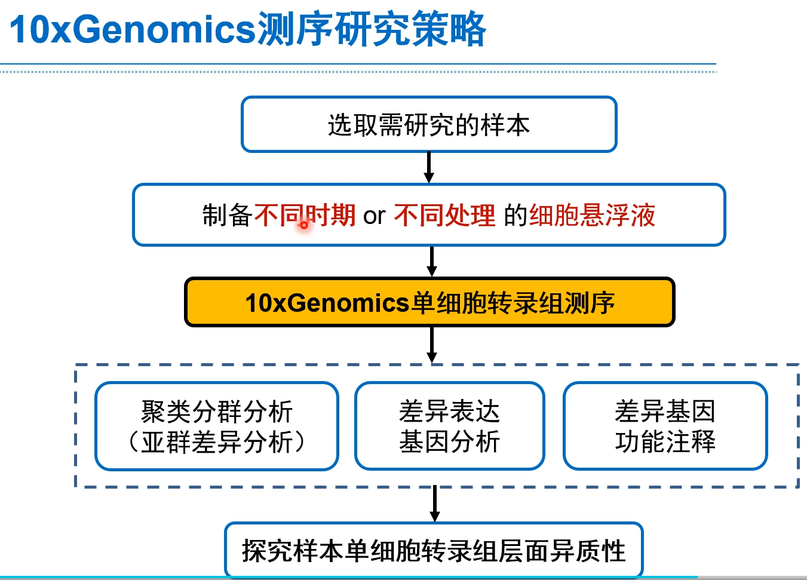

Slide 21
Outline
单细胞技术背景和需求
10X genomics 高通量单细胞技术
单细胞获取+测序技术
临床应用前景

Slide 22
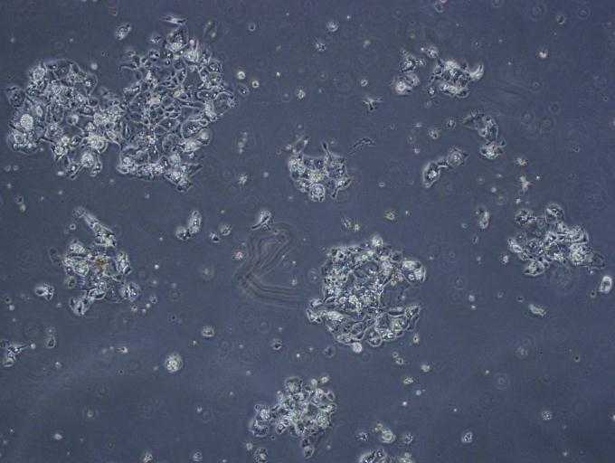
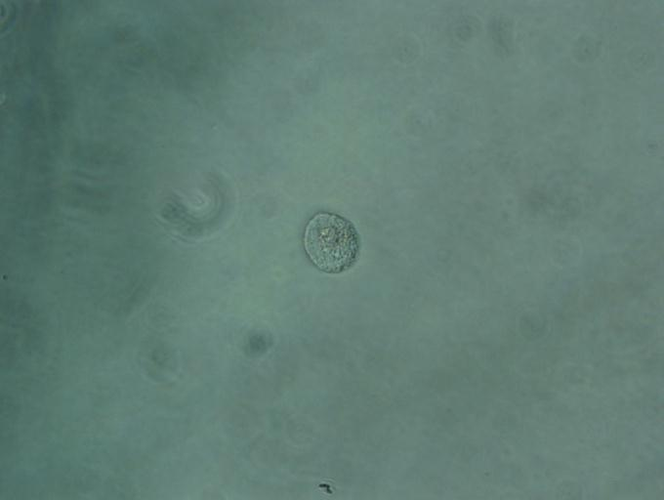

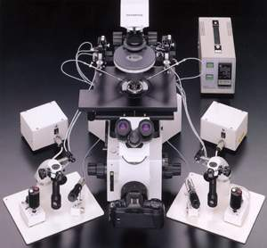
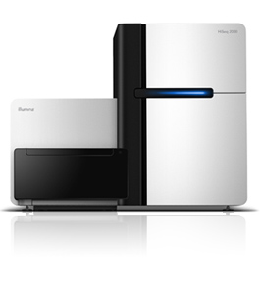
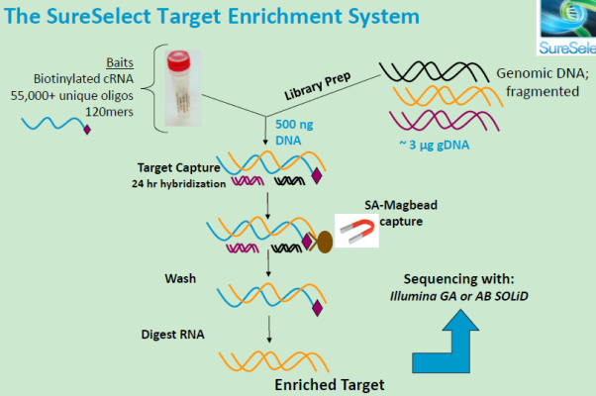
Single cell sequencing
Cell isolation
Amplification
Digested Tissues
Single Cell
Enough Amount of DNA/cDNA
Bioinformatics Analysis
NGS
Library Preparation

Slide 23
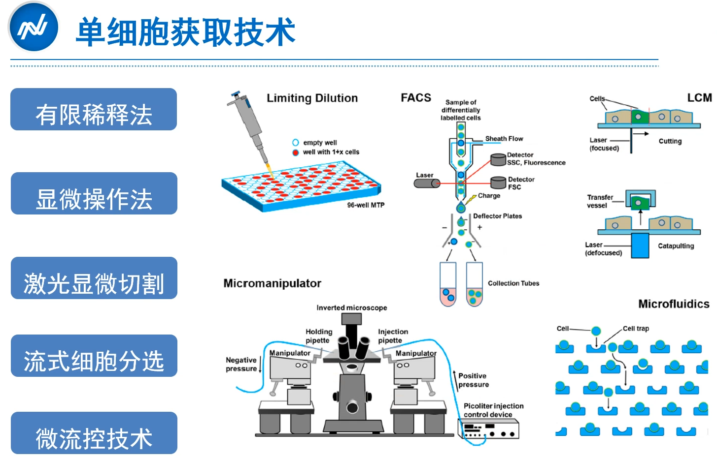

Slide 24
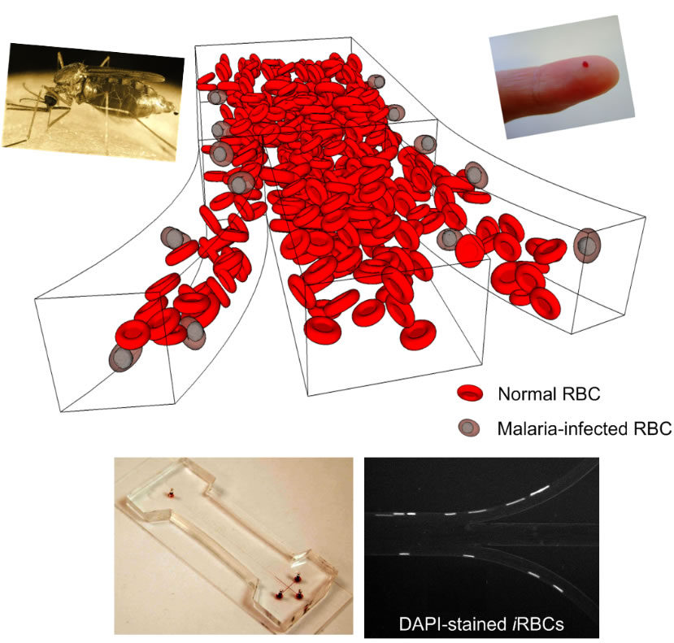
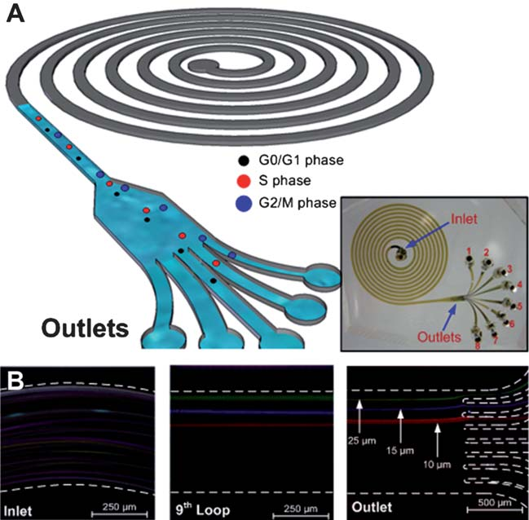
Single cell isolation
Question:
User friendly?
Modulated?
Advantage:
High throughput;
Automatic
Microfluidics:

Slide 25
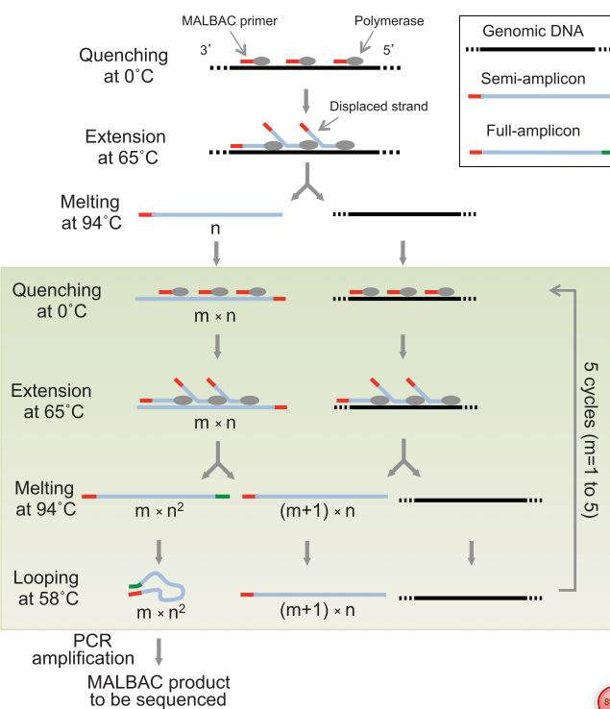
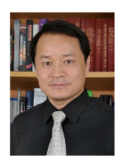
Amplification --- genome
Multiple displacement amplification(MDA)
多重置换扩增
Multiple annealing and looping-based amplification cycles (MALBAC)
多次退火循环扩增
北京大学谢晓亮教授 美国科学院院士，原哈佛大学终身教授
C. Zong*, S. Lu*, A.R. Chapman*, X.S. Xie Genome-Wide Detection of Single Nucleotide and Copy Number Variations of a Single Human Cell
Science .338:1622 (2012)
S. Lu*, C. Zong*, W.Fan*, M. Yang*, et al., Probing Meiotic Recombination and Aneuploidy of Single Sperm Cells by Whole Genome Sequencing using MALBAC Science . 338:1627 (2012)

Slide 26
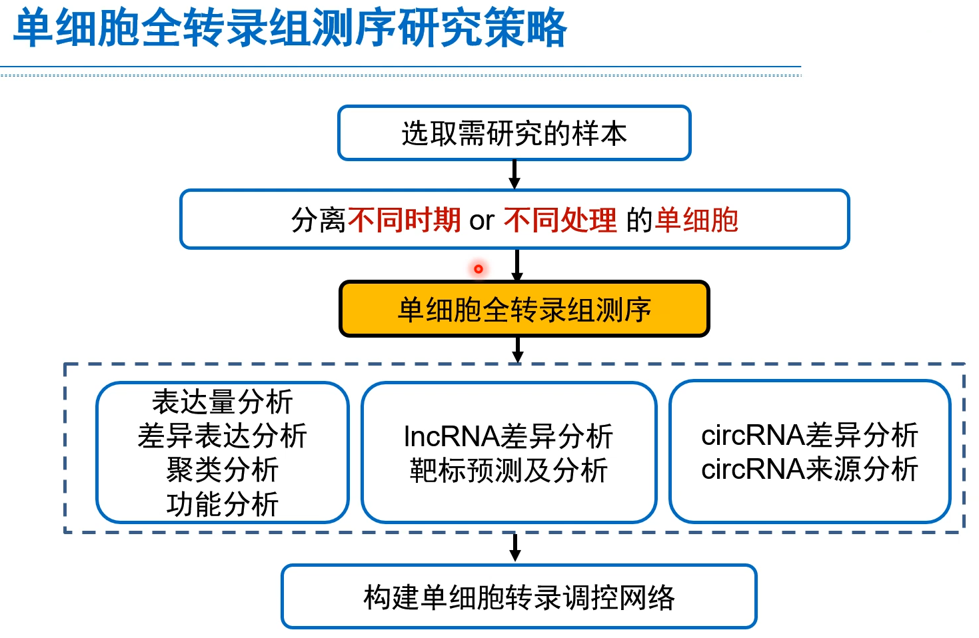

Slide 27
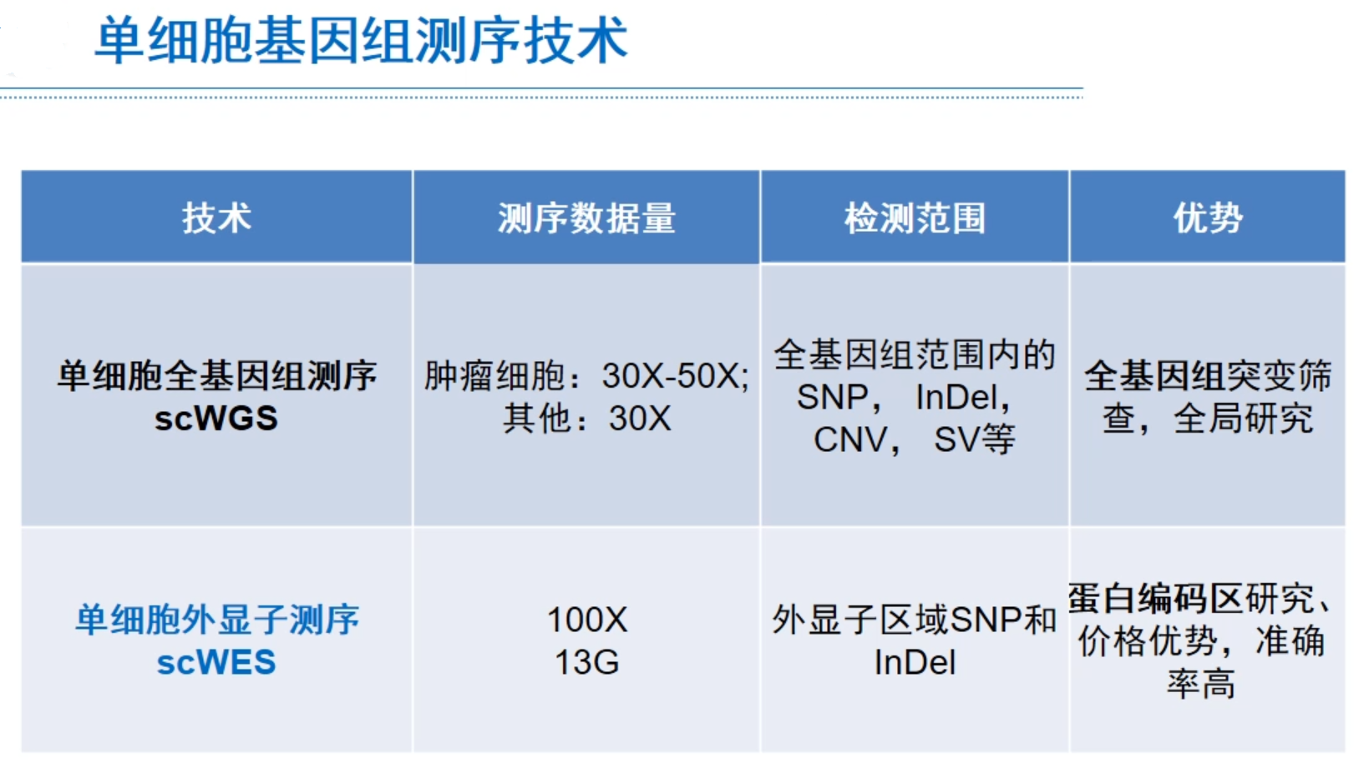

Slide 28
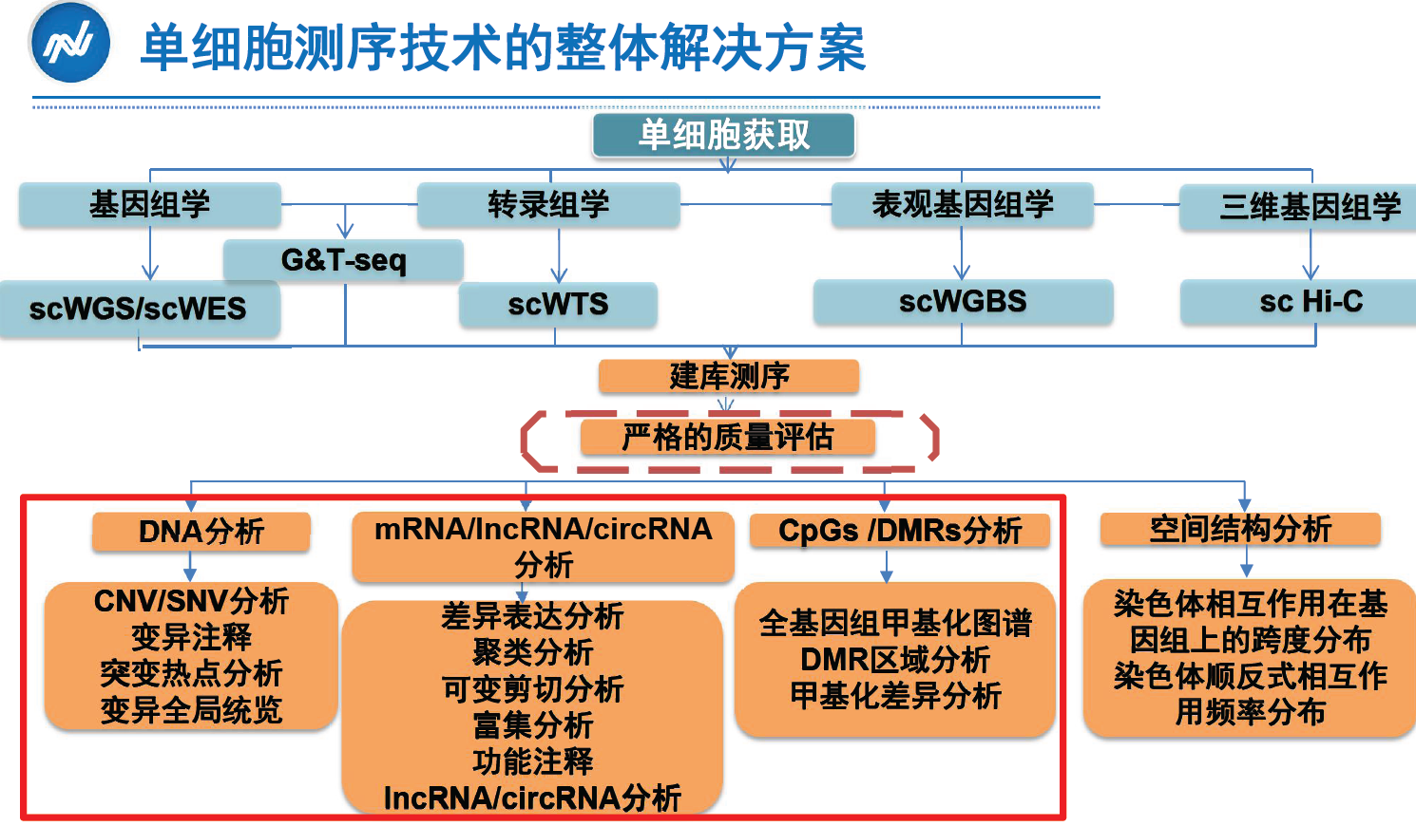

Slide 29
Somatic mutation calling
Population analysis
Progression inferring (key genes)
Single Cell Sequencing of Primary Tumors
Analysis pipeline
Observe the somatic mutation pattern in single cell level
Somatic mutation statistics
Derived allelic frequency spectrum of somatic mutations
Mutation prevalence of single cell level in different tumors
Somatic mutation types of single cell level in different tumors
Tumor-mutated genes
Functional validation
Notes:
When inferring the population structure, We filtered the polymorphism sites in human (dbSNP, YHSNP, KSNP) and mutated sites which also appeared mutated in normal cells;
Here we defined somatic mutations as follows: a site has coincident homozygous allele type in normal cells but different allele type appeared in cancer cells.
When identifying the somatic mutations, we removed the extremely rare mutated sites with a frequency of 1/n，which may due to the amplification, capture and sequencing error and these sites have little to do with tumor progression.

Slide 30
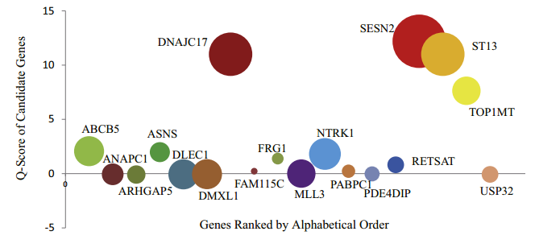
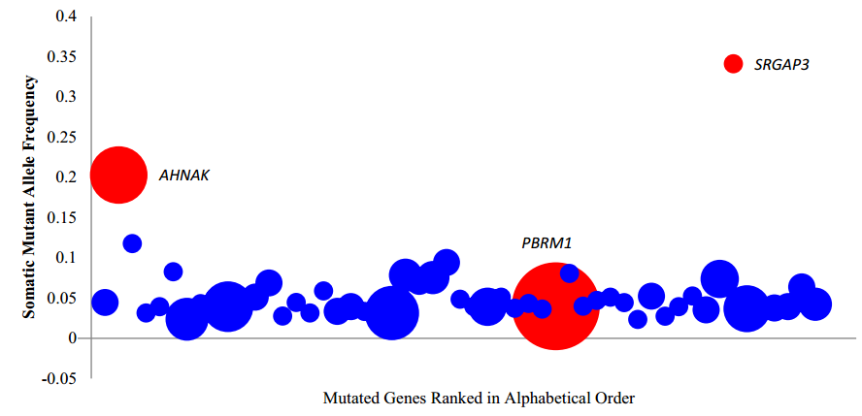
Key mutations
Notes:
To identify key genes underlying ET monoclonal initiation and progression, We determined which of these 71 genes were likely to contain protein-damaging mutations or had been identiﬁed previously as associated with cancer. Using SIFT ( Kumar et al., 2009 ), we
found that 15 genes were likely to contain protein-damaging mutations (including protein truncation). We also found that three
additional genes of the 71 ( MLL3, NTRK1 , and PDE4DIP) were present in the COSMIC Cancer Gene Census database.

Slide 31
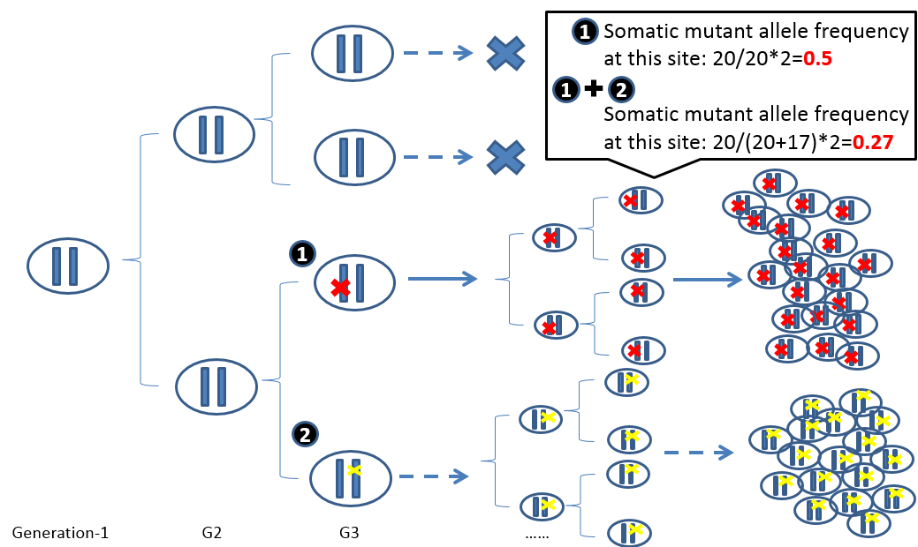
Evolution analysis
Tumor clonal evolution model

Slide 32
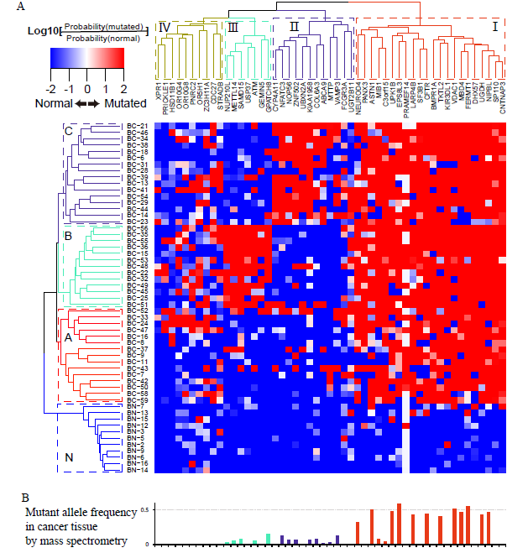
Bladder Cancer (BTCC)
Evolution analysis
Progression:
C
The tumour cells could be classified into 3 identifiable subclones with different mutational signatures with 3 different groups of genes (A, B, C); N represents normal cells here.
B
A
N
Notes:
We validated our observation on the mass spectrum signal from the cancer tissue

Slide 33
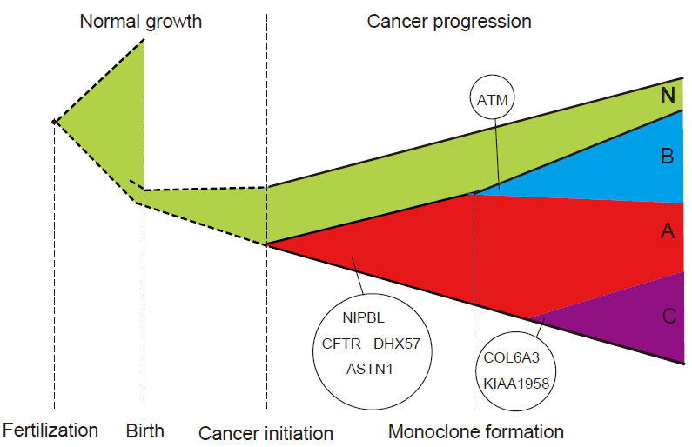
Bladder Cancer (BTCC)
Evolution analysis
Progression:
These two clones may paly roles in the aggressive phenotype of stage II ( T2-N0M0) and also growth advantage maintaining.
The tumour evolution inferred by the heatmap
Notes:
Next, we surveyed identified commonly mutant genes in a cohort of 100 BTCC patients exome sequencing study (Gui et al 2011).
Strikingly, in concordance with our above inferences from clone structure analysis, we additionally found clone-specific genes that are high-potential driver genes unique to both clones A and B, which could further increase their growth advantage over other tumour cells (Clone C). In Clone A, ATM is specifically mutated and found recurring in 5 other TCC patients. It is a known tumour suppressor that plays a key role as a cell cycle checkpoint kinase in response to DNA damage and is a regulator of a wide variety of downstream proteins(Rotman and Shiloh 1998; Branzei and Foiani 2008). Defects in this gene could increase mutation rate and genome instability and facilitate tumour progression. Clone-B-specific mutated genes COL6A3 and KIAA1958 both recurred in 4 additional patients. COL6A3 is reported to have significant changes in expression level in tumour tissue(Smith, Culhane et al. 2009) and is a subunit of collagen IV, a cancer biomarker(Ohlund, Lundin et al. 2009). The role of KIAA1958 remains uncharacterized. These clone-specific cancer-associated genes could contribute to additional growth advantage and/or survival of respective cell lineages, which supports the above inferences on constant positive selection pressure and faster expansion rate of Clone A and B. The observation also indicates that new driver genes and phenotypic characteristics continue to be gained during the tumour progression, which again underscores the nature of MI-TCC: life-threatening with high metastatic potential.

Slide 34
Outline
单细胞技术背景和需求
10X genomics 高通量单细胞技术
单细胞获取+测序技术
临床应用前景

Slide 35
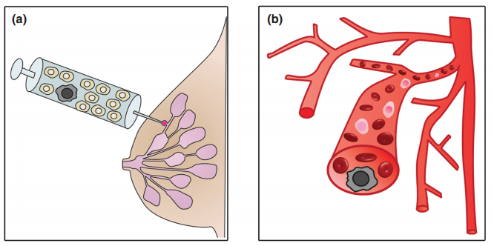
Early diagnose and prognosis
Detection of rare tumor cells in clinical samples----Noninvasive or minimally invasive diagnose
Prognosis-related genes
For example, PABPC1 has been identified as a prognostic indicator in some cancers.
Only 5% to 10% of patients with low-grade ductal carcinoma in situ (DCIS) (a kind of breast cancer at the early stage), will progress to invasive carcinomas

Slide 36


Personalized treatment & dynamic monitoring
Target-drugs design
Treatment strategies---“cocktail(鸡尾酒)”treatment
Tumor “stem cell” detection
Dynamic monitoring
Target sites
Drug trial

Slide 37
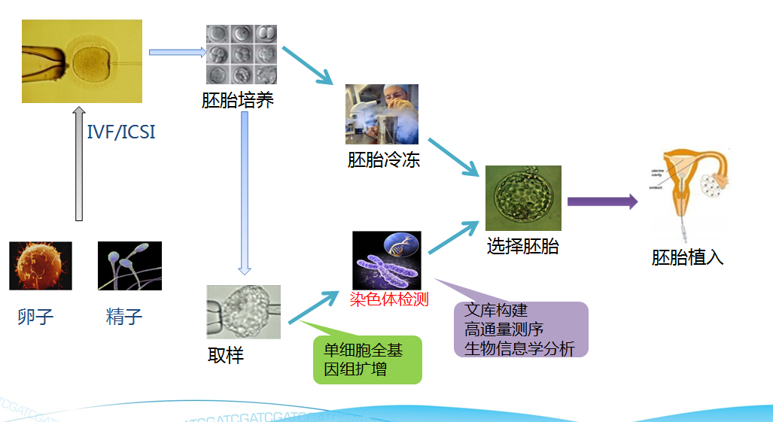
植入前遗传学诊断PGD
PGD，在试管婴儿胚胎植入前取单细胞进行检测，选择健康胚胎进行植入，提高质量。

